Slide 1
Tactics for Building Background Services in .NET
Kevin Griffin
twitter.com/1kevgriff
@1kevgriff@bbiz.io

Slide 2

Notes:
Story: the on-demand email

Slide 3
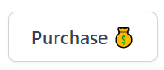
Create Order
Check Inventory
Charge Credit Card
Send Email

Slide 4
Create Order
Check Inventory
Charge Credit Card
Send Email

Slide 5

👋 I’m Kevin
Kevin Griffin
13-time Microsoft MVP
ASP.NET Core, Azure, and Web
consultwithgriff.com
twitter.com/@1kevgriff
bbiz.io/@1kevgriff

Slide 6
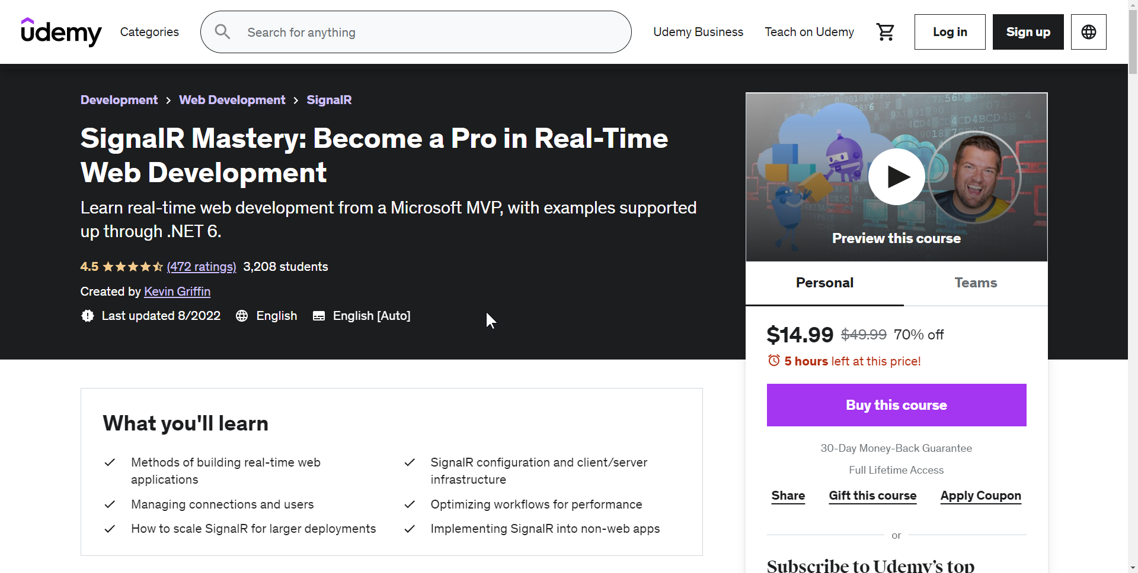
Courses
https://www.udemy.com/course/signalr-mastery/?couponCode=TULSADOTNET

Slide 7

Agenda
Background Tasks
Notes:
Adding tools to your tool box

Slide 8
Create Order
Check Inventory
Charge Credit Card
Send Email

Slide 9
Create Order
Check Inventory
Charge Credit Card
Send Email
Notes:
We have a big di

Slide 10

Background Tasks
On Demand
Tasks that need to occur sooner than later
Might be a workflow!
Examples:
Emails
Payment Processing
Webhooks
Entity Processing

Slide 11

Background Tasks
Recurring or Scheduled Task
Tasks that need to happen on a schedule
Hourly, Daily, Weekly, etc
Examples:
Reports
Resource Cleanup

Slide 12
Considerations
Where are you hosting?
Local
Windows Service
Inside existing client app
Web
ASP.NET Core app
Microsoft Azure

Slide 13
Considerations
Resiliency
What happens if a task fails?
What happens if a service crashes?

Slide 14
Agenda
Background Tasks
Tactics
Hosted Services
Windows Services
ASP.NET Core Hosted Services
Quartz
HangFire
Azure Functions

Slide 15
.NET Hosted Services

Slide 16
.NET Hosted Services
.NET Host
Hosted Service
Hosted Service
Hosted Service
Hosted Service
Hosted Service

Slide 17
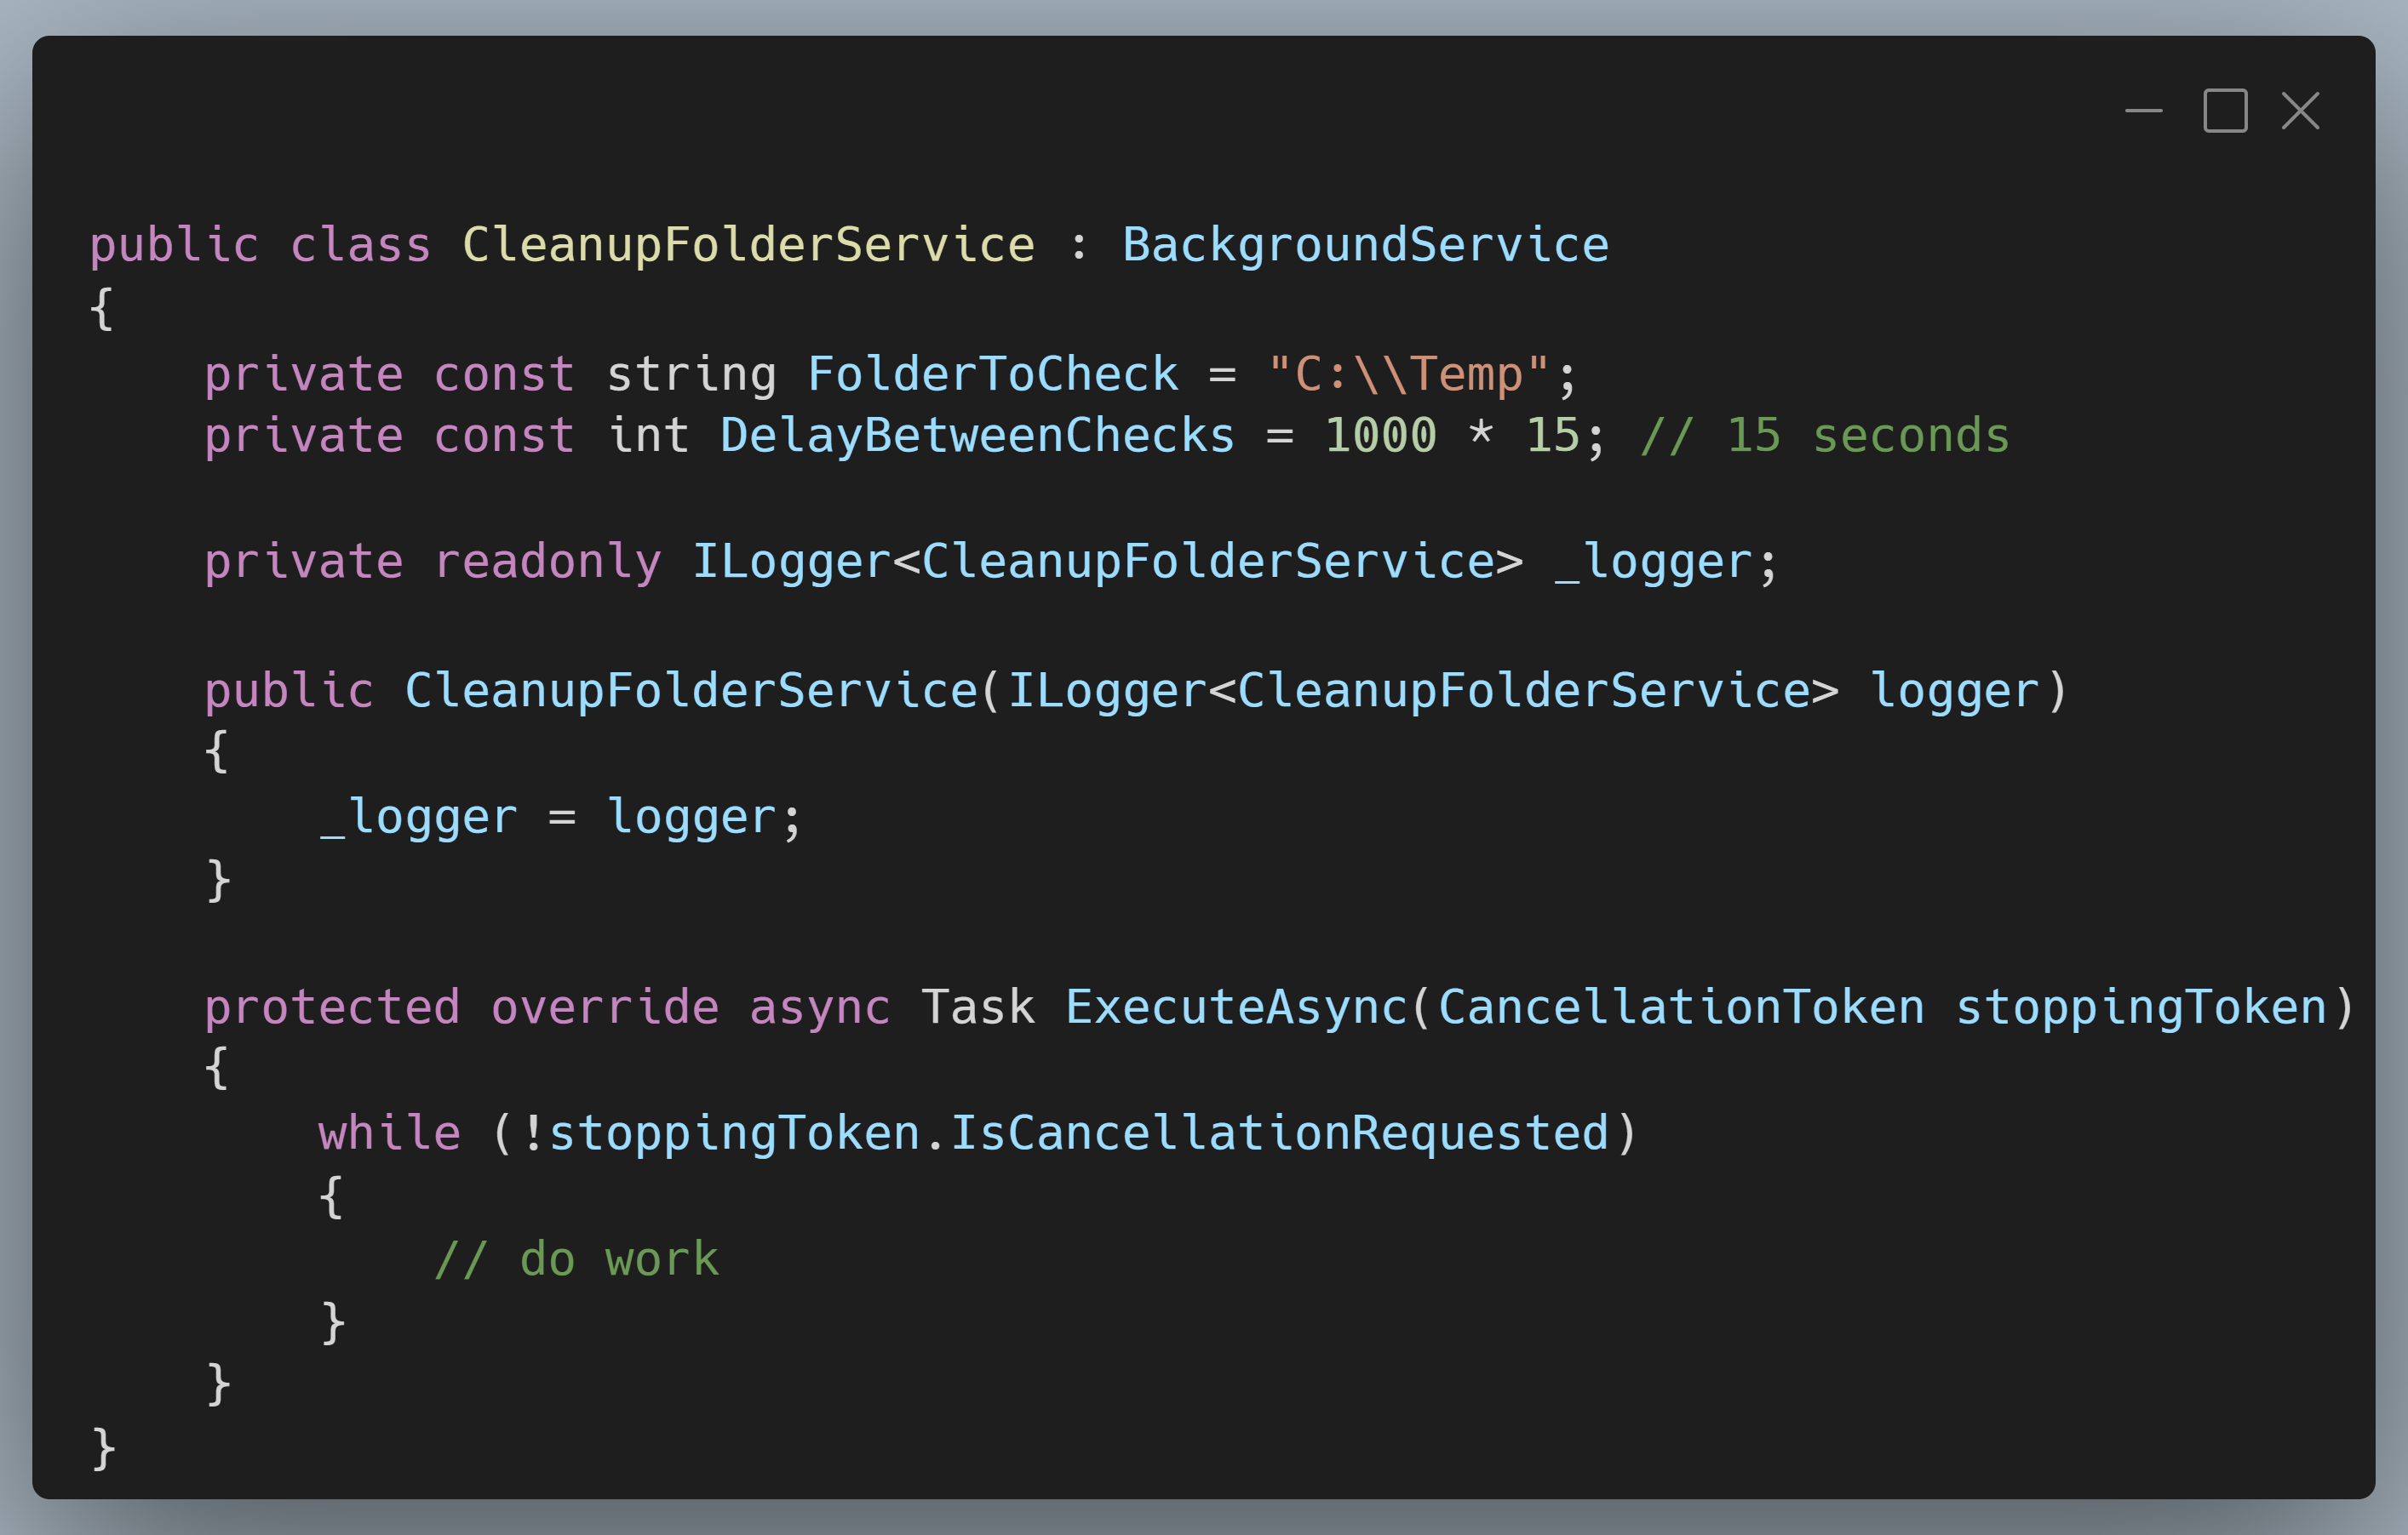
.NET Hosted Services
Notes:
Introduce concept of hosted services
Examples in .NET Console and ASP.NET Core
Screenshot: https://carbon.now.sh/?bg=rgba%28171%2C+184%2C+195%2C+1%29&t=vscode&wt=boxy&l=text%2Fx-csharp&width=680&ds=true&dsyoff=20px&dsblur=68px&wc=true&wa=true&pv=11px&ph=10px&ln=false&fl=1&fm=Hack&fs=14px&lh=133%25&si=false&es=4x&wm=false&code=public%2520class%2520CleanupFolderService%2520%253A%2520BackgroundService%250A%257B%250A%2520%2520%2520%2520private%2520const%2520string%2520FolderToCheck%2520%253D%2520%2522C%253A%255C%255CTemp%2522%253B%250A%2520%2520%2520%2520private%2520const%2520int%2520DelayBetweenChecks%2520%253D%25201000%2520*%252015%253B%2520%252F%252F%252015%2520seconds%250A%250A%2520%2520%2520%2520private%2520readonly%2520ILogger%253CCleanupFolderService%253E%2520_logger%253B%250A%250A%2520%2520%2520%2520public%2520CleanupFolderService%28ILogger%253CCleanupFolderService%253E%2520logger%29%250A%2520%2520%2520%2520%257B%250A%2520%2520%2520%2520%2520%2520%2520%2520_logger%2520%253D%2520logger%253B%250A%2520%2520%2520%2520%257D%250A%250A%2520%2520%2520%2520protected%2520override%2520async%2520Task%2520ExecuteAsync%28CancellationToken%2520stoppingToken%29%250A%2520%2520%2520%2520%257B%250A%2520%2520%2520%2520%2520%2520%2520%2520while%2520%28%21stoppingToken.IsCancellationRequested%29%250A%2520%2520%2520%2520%2520%2520%2520%2520%257B%250A%2520%2520%2520%2520%2520%2520%2520%2520%2509%252F%252F%2520do%2520work%250A%2520%2520%2520%2520%2520%2520%2520%2520%257D%250A%2520%2520%2520%2520%257D%250A%257D

Slide 18
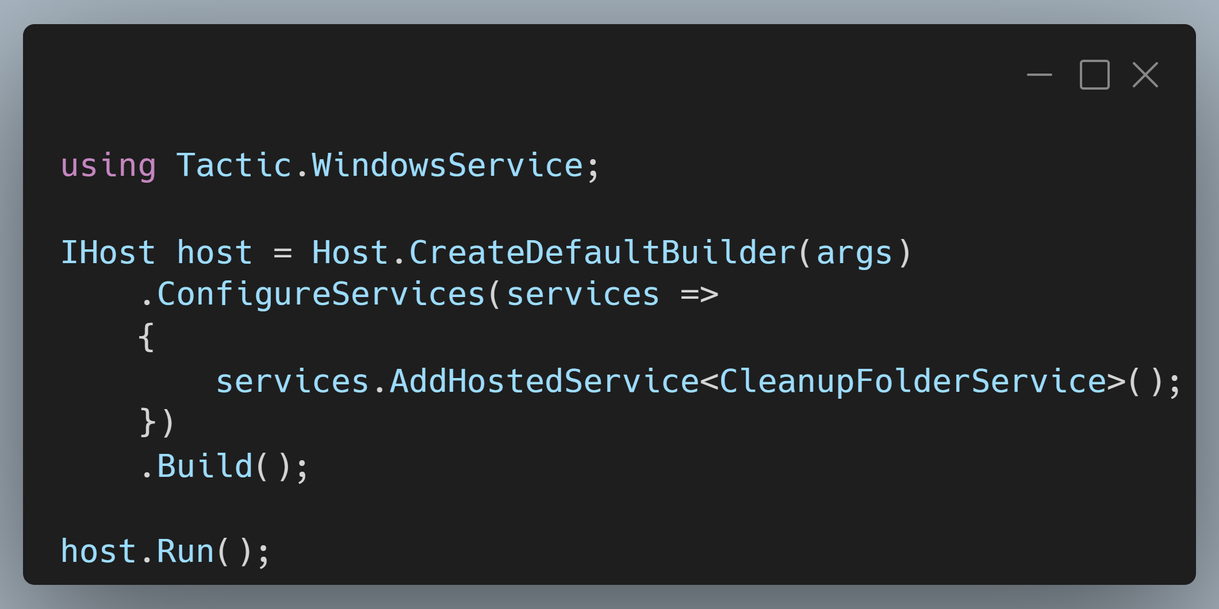
.NET Hosted Services
Notes:
Screenshot: https://carbon.now.sh/?bg=rgba%28171%2C+184%2C+195%2C+1%29&t=vscode&wt=boxy&l=text%2Fx-csharp&width=680&ds=true&dsyoff=20px&dsblur=68px&wc=true&wa=true&pv=11px&ph=10px&ln=false&fl=1&fm=Hack&fs=14px&lh=133%25&si=false&es=4x&wm=false&code=using%2520Tactic.WindowsService%253B%250A%250AIHost%2520host%2520%253D%2520Host.CreateDefaultBuilder%28args%29%250A%2520%2520%2520%2520.ConfigureServices%28services%2520%253D%253E%250A%2520%2520%2520%2520%257B%250A%2520%2520%2520%2520%2520%2520%2520%2520services.AddHostedService%253CCleanupFolderService%253E%28%29%253B%250A%2520%2520%2520%2520%257D%29%250A%2520%2520%2520%2520.Build%28%29%253B%250A%250Ahost.Run%28%29%253B

Slide 19
Windows Service

Slide 20
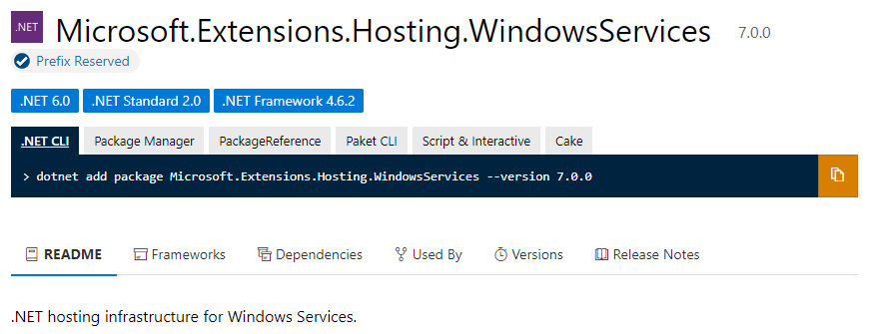
Windows Services

Slide 21
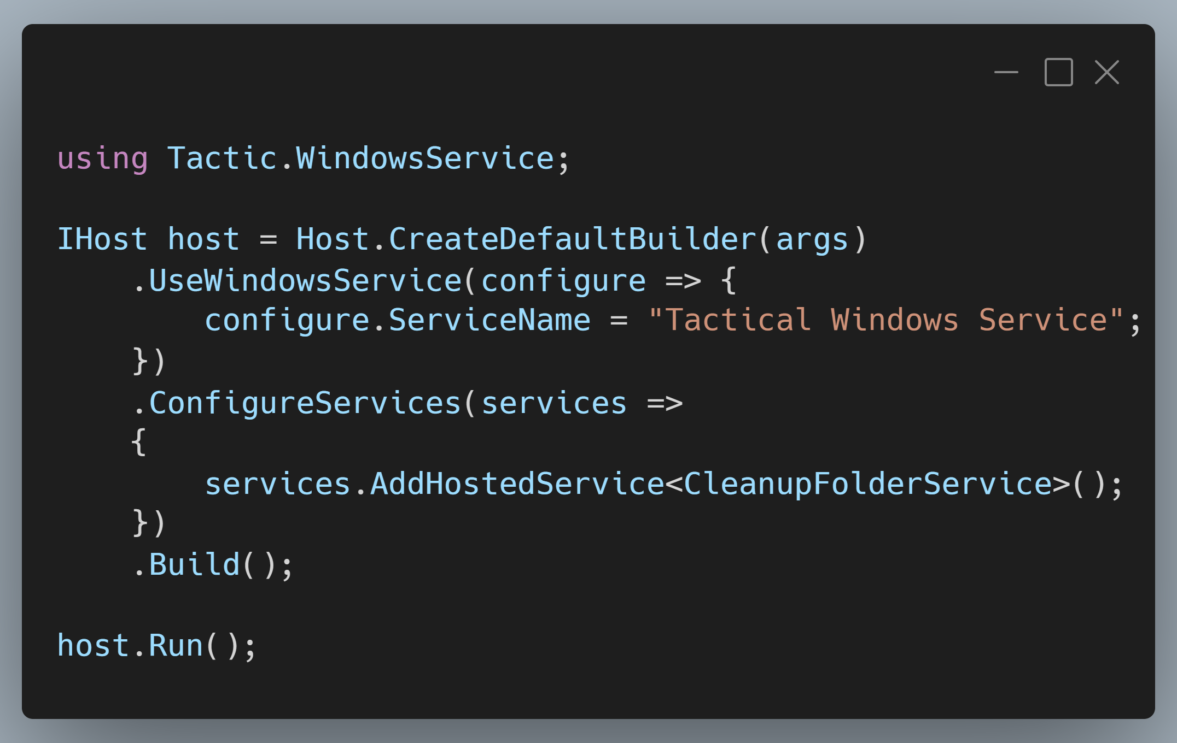
Windows Services
Notes:
Screenshot: https://carbon.now.sh/?bg=rgba%28171%2C+184%2C+195%2C+1%29&t=vscode&wt=boxy&l=text%2Fx-csharp&width=680&ds=true&dsyoff=20px&dsblur=68px&wc=true&wa=true&pv=11px&ph=10px&ln=false&fl=1&fm=Hack&fs=14px&lh=133%25&si=false&es=4x&wm=false&code=using%2520Tactic.WindowsService%253B%250A%250AIHost%2520host%2520%253D%2520Host.CreateDefaultBuilder%28args%29%250A%2520%2520%2520%2520.UseWindowsService%28configure%2520%253D%253E%2520%257B%250A%2520%2520%2520%2520%2520%2520%2520%2520configure.ServiceName%2520%253D%2520%2522Tactical%2520Windows%2520Service%2522%253B%250A%2520%2520%2520%2520%257D%29%250A%2520%2520%2520%2520.ConfigureServices%28services%2520%253D%253E%250A%2520%2520%2520%2520%257B%250A%2520%2520%2520%2520%2520%2520%2520%2520services.AddHostedService%253CCleanupFolderService%253E%28%29%253B%250A%2520%2520%2520%2520%257D%29%250A%2520%2520%2520%2520.Build%28%29%253B%250A%250Ahost.Run%28%29%253B%250A

Slide 22
Demo
Windows Services
Notes:
### Create the Windows Service
At the COMMAND PROMPT (as Administrator), run the command:
```bash
sc create Tactic.WindowsService binPath= "{path to your application}\Tactic.WindowsService\publish\Tactic.WindowsService.exe"
```
### Start the Windows Service
At the COMMAND PROMPT (as Administrator), run the command:
```bash
sc start Tactic.WindowsService
```
### Stop the Windows Service
At the COMMAND PROMPT (as Administrator), run the command:
```bash
sc stop Tactic.WindowsService
```

Slide 23
Window Services
Pros
Easy to build!
Windows will automatically manage lifecycle for you
Cons
Limited to single machine/server
Not straight forward to do “on-demand” work
You’re responsible for resiliency of individual tasks

Slide 24
ASP.NET Core Hosted Services

Slide 25
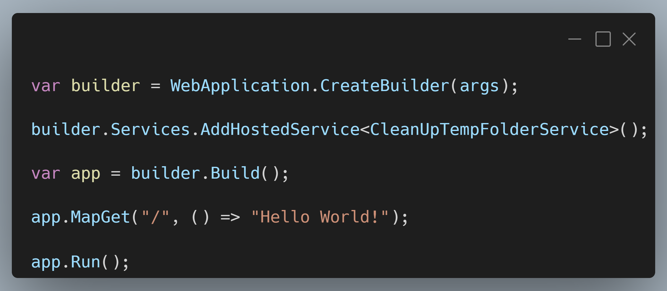
ASP.NET Core Hosted Services
Notes:
SCREENSHOT: https://carbon.now.sh/?bg=rgba%28171%2C+184%2C+195%2C+1%29&t=vscode&wt=boxy&l=text%2Fx-csharp&width=680&ds=true&dsyoff=20px&dsblur=68px&wc=true&wa=true&pv=11px&ph=10px&ln=false&fl=1&fm=Hack&fs=14px&lh=133%25&si=false&es=4x&wm=false&code=var%2520builder%2520%253D%2520WebApplication.CreateBuilder%28args%29%253B%250A%250Abuilder.Services.AddHostedService%253CCleanUpTempFolderService%253E%28%29%253B%250A%250Avar%2520app%2520%253D%2520builder.Build%28%29%253B%250A%250Aapp.MapGet%28%2522%252F%2522%252C%2520%28%29%2520%253D%253E%2520%2522Hello%2520World%21%2522%29%253B%250A%250Aapp.Run%28%29%253B

Slide 26
Demo
ASP.NET Core Hosted Services

Slide 27
ASP.NET Core Hosted Services
Pros
Easy to build!
Runs inside of your existing ASP.NET Core Host
Automatically starts on app startup
Cons
You’re responsible for scheduling (with Quartz or custom process)
You’re responsible for resiliency of individual tasks

Slide 28
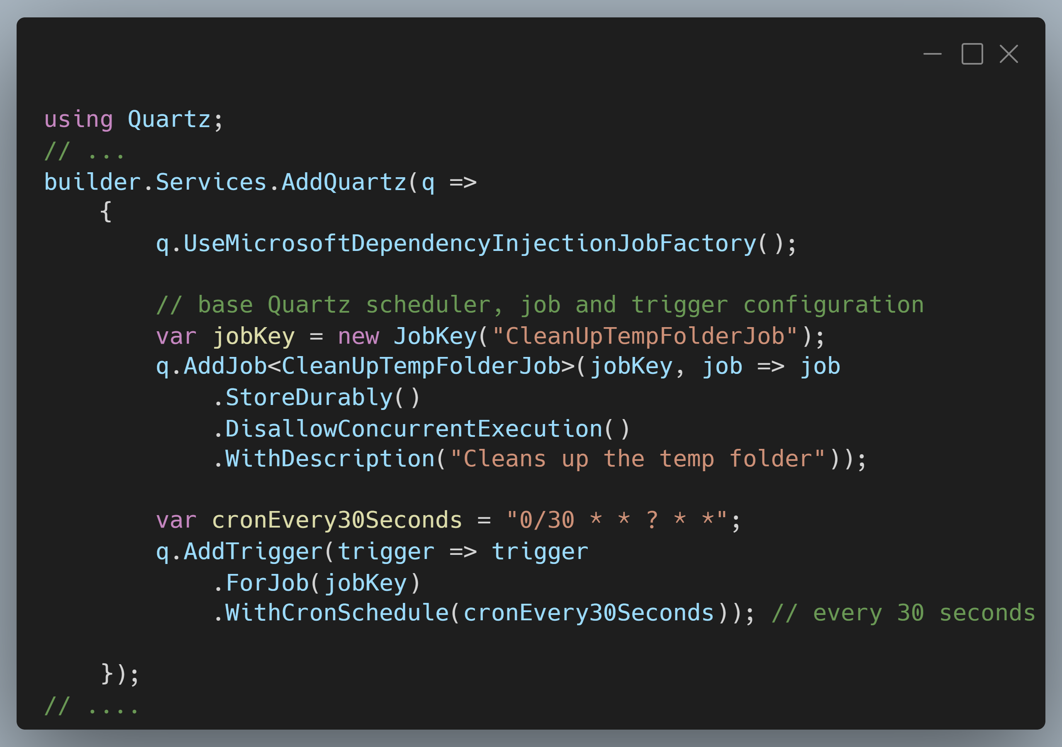
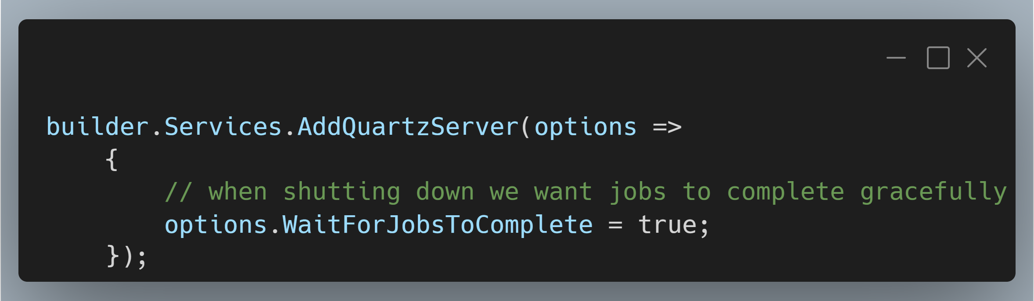
Scheduling with Quartz
Notes:
SCREENSHOT 1: https://carbon.now.sh/?bg=rgba%28171%2C+184%2C+195%2C+1%29&t=vscode&wt=boxy&l=text%2Fx-csharp&width=680&ds=true&dsyoff=20px&dsblur=68px&wc=true&wa=true&pv=11px&ph=10px&ln=false&fl=1&fm=Hack&fs=14px&lh=133%25&si=false&es=4x&wm=false&code=using%2520Quartz%253B%250A%252F%252F%2520...%250Abuilder.Services.AddQuartz%28q%2520%253D%253E%250A%2520%2520%2520%2520%257B%250A%2520%2520%2520%2520%2520%2520%2520%2520q.UseMicrosoftDependencyInjectionJobFactory%28%29%253B%250A%250A%2520%2520%2520%2520%2520%2520%2520%2520%252F%252F%2520base%2520Quartz%2520scheduler%252C%2520job%2520and%2520trigger%2520configuration%250A%2520%2520%2520%2520%2520%2520%2520%2520var%2520jobKey%2520%253D%2520new%2520JobKey%28%2522CleanUpTempFolderJob%2522%29%253B%250A%2520%2520%2520%2520%2520%2520%2520%2520q.AddJob%253CCleanUpTempFolderJob%253E%28jobKey%252C%2520job%2520%253D%253E%2520job%250A%2520%2520%2520%2520%2520%2520%2520%2520%2520%2520%2520%2520.StoreDurably%28%29%250A%2520%2520%2520%2520%2520%2520%2520%2520%2520%2520%2520%2520.DisallowConcurrentExecution%28%29%250A%2520%2520%2520%2520%2520%2520%2520%2520%2520%2520%2520%2520.WithDescription%28%2522Cleans%2520up%2520the%2520temp%2520folder%2522%29%29%253B%250A%250A%2520%2520%2520%2520%2520%2520%2520%2520var%2520cronEvery30Seconds%2520%253D%2520%25220%252F30%2520*%2520*%2520%253F%2520*%2520*%2522%253B%250A%2520%2520%2520%2520%2520%2520%2520%2520q.AddTrigger%28trigger%2520%253D%253E%2520trigger%250A%2520%2520%2520%2520%2520%2520%2520%2520%2520%2520%2520%2520.ForJob%28jobKey%29%250A%2520%2520%2520%2520%2520%2520%2520%2520%2520%2520%2520%2520.WithCronSchedule%28cronEvery30Seconds%29%29%253B%2520%252F%252F%2520every%252030%2520seconds%250A%250A%2520%2520%2520%2520%257D%29%253B%250A%252F%252F%2520....
Screenshot 2: https://carbon.now.sh/?bg=rgba%28171%2C+184%2C+195%2C+1%29&t=vscode&wt=boxy&l=text%2Fx-csharp&width=680&ds=true&dsyoff=20px&dsblur=68px&wc=true&wa=true&pv=11px&ph=10px&ln=false&fl=1&fm=Hack&fs=14px&lh=133%25&si=false&es=4x&wm=false&code=builder.Services.AddQuartzServer%28options%2520%253D%253E%250A%2520%2520%2520%2520%257B%250A%2520%2520%2520%2520%2520%2520%2520%2520%252F%252F%2520when%2520shutting%2520down%2520we%2520want%2520jobs%2520to%2520complete%2520gracefully%250A%2520%2520%2520%2520%2520%2520%2520%2520options.WaitForJobsToComplete%2520%253D%2520true%253B%250A%2520%2520%2520%2520%257D%29%253B

Slide 29
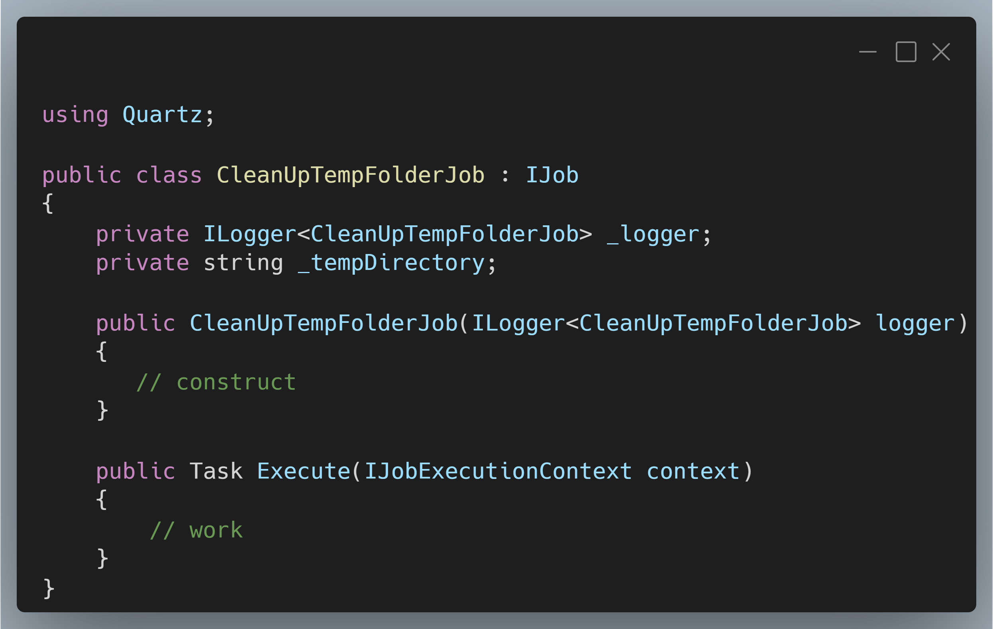
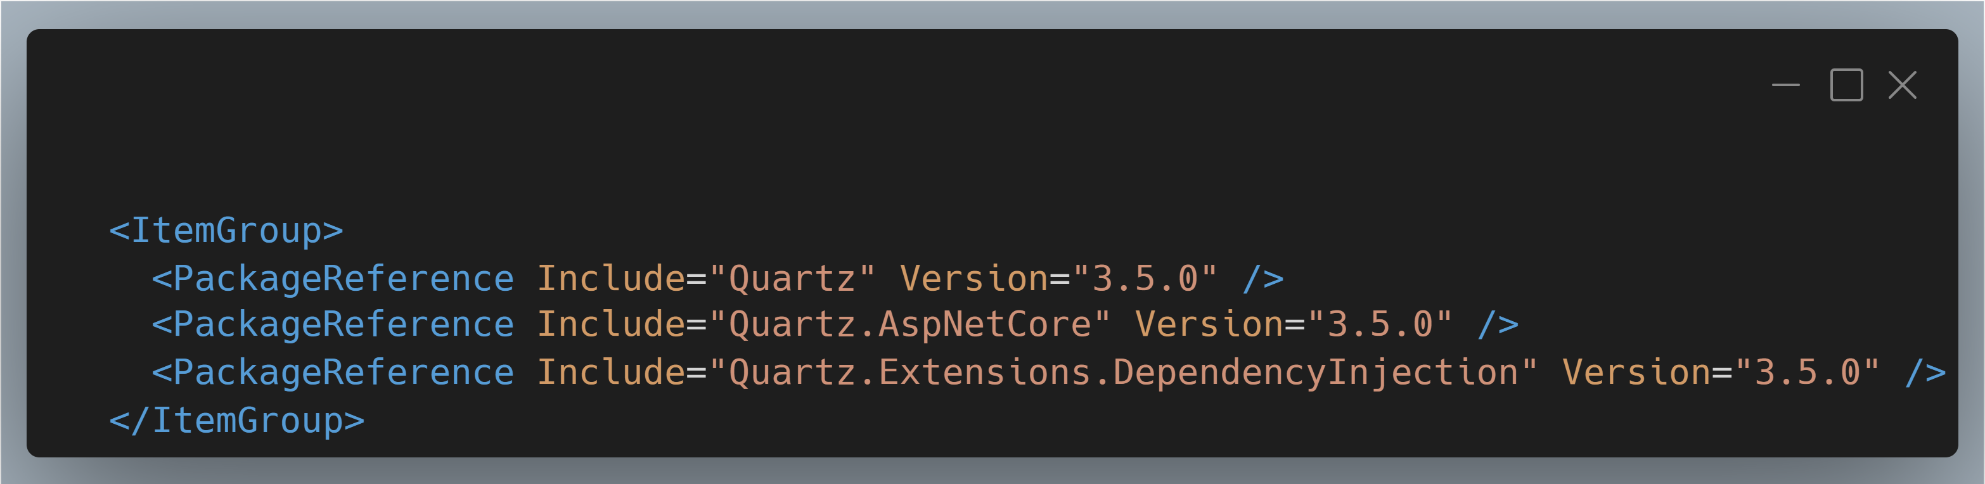
Scheduling with Quartz

Slide 30
Demo
Quartz

Slide 31
Quartz
Pros
Precise scheduling and timing!
One off jobs as you want to schedule them
Separate “job server” so your app isn’t doing dual duty
Cons
Locking into Quartz jobs
Additional configuration to tie into DI framework

Slide 32
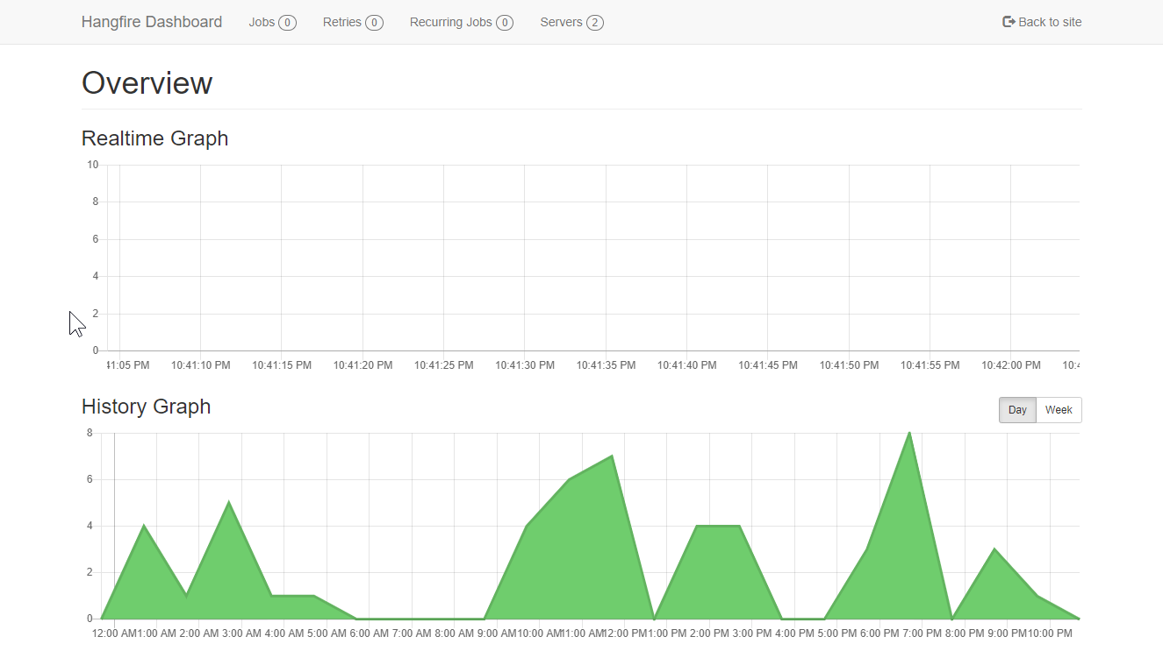
HangFire

Slide 33
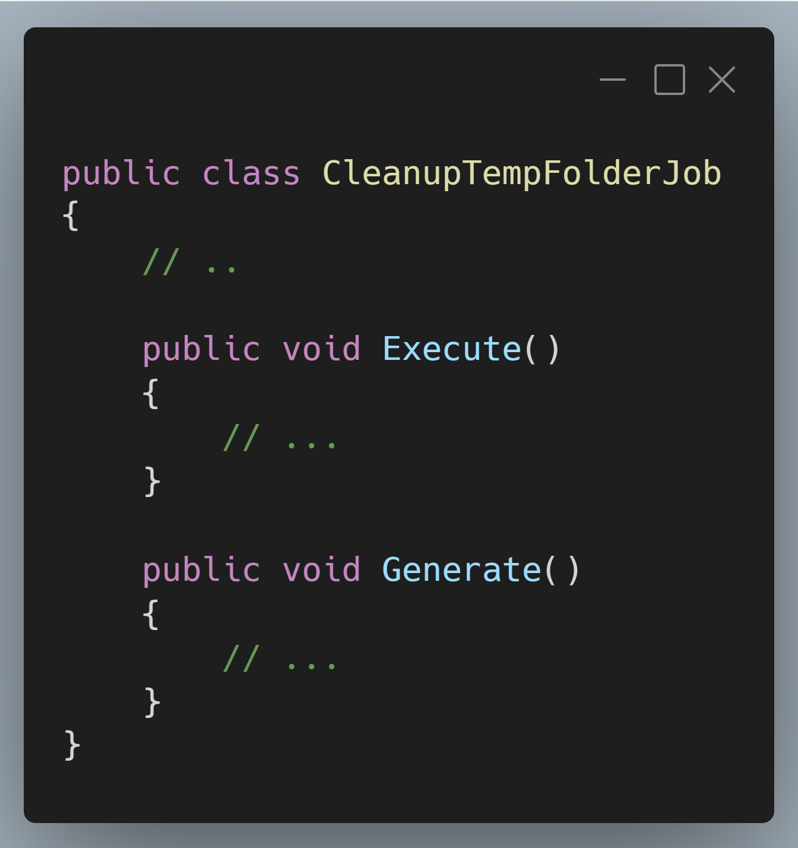
HangFire
Notes:
SCREENSHOT: https://carbon.now.sh/?bg=rgba%28171%2C+184%2C+195%2C+1%29&t=vscode&wt=boxy&l=text%2Fx-csharp&width=680&ds=true&dsyoff=20px&dsblur=68px&wc=true&wa=true&pv=11px&ph=10px&ln=false&fl=1&fm=Hack&fs=14px&lh=133%25&si=false&es=4x&wm=false&code=public%2520class%2520CleanupTempFolderJob%250A%257B%250A%2520%2520%2509%252F%252F%2520..%250A%250A%2520%2520%2520%2520public%2520void%2520Execute%28%29%250A%2520%2520%2520%2520%257B%250A%2509%2509%252F%252F%2520...%250A%2520%2520%2520%2520%257D%250A%250A%2520%2520%2520%2520public%2520void%2520Generate%28%29%250A%2520%2520%2520%2520%257B%250A%2520%2520%2520%2520%2520%2520%2520%2520%252F%252F%2520...%250A%2520%2520%2520%2520%257D%250A%257D

Slide 34
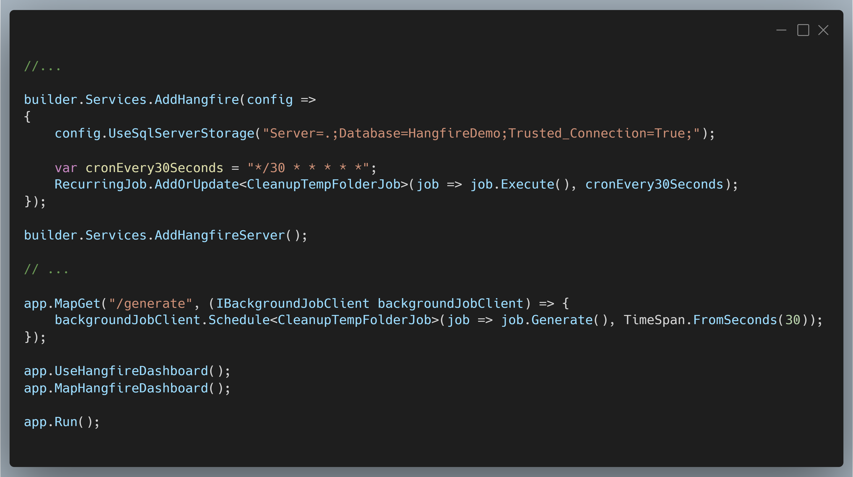
HangFire
Notes:
Screenshot: https://carbon.now.sh/?bg=rgba%28171%2C+184%2C+195%2C+1%29&t=vscode&wt=boxy&l=text%2Fx-csharp&width=680&ds=true&dsyoff=20px&dsblur=68px&wc=true&wa=true&pv=11px&ph=10px&ln=false&fl=1&fm=Hack&fs=14px&lh=133%25&si=false&es=4x&wm=false&code=%252F%252F...%250A%250Abuilder.Services.AddHangfire%28config%2520%253D%253E%250A%257B%250A%2520%2520%2520%2520config.UseSqlServerStorage%28%2522Server%253D.%253BDatabase%253DHangfireDemo%253BTrusted_Connection%253DTrue%253B%2522%29%253B%250A%250A%2520%2520%2520%2520var%2520cronEvery30Seconds%2520%253D%2520%2522*%252F30%2520*%2520*%2520*%2520*%2520*%2522%253B%250A%2520%2520%2520%2520RecurringJob.AddOrUpdate%253CCleanupTempFolderJob%253E%28job%2520%253D%253E%2520job.Execute%28%29%252C%2520cronEvery30Seconds%29%253B%250A%257D%29%253B%250A%250Abuilder.Services.AddHangfireServer%28%29%253B%250A%250A%252F%252F%2520...%250A%250Aapp.MapGet%28%2522%252Fgenerate%2522%252C%2520%28IBackgroundJobClient%2520backgroundJobClient%29%2520%253D%253E%2520%257B%250A%2520%2520%2520%2520backgroundJobClient.Schedule%253CCleanupTempFolderJob%253E%28job%2520%253D%253E%2520job.Generate%28%29%252C%2520TimeSpan.FromSeconds%2830%29%29%253B%250A%257D%29%253B%250A%250Aapp.UseHangfireDashboard%28%29%253B%250Aapp.MapHangfireDashboard%28%29%253B%250A%250Aapp.Run%28%29%253B%250A

Slide 35
Demo
HangFire

Slide 36
HangFire
Pros
Precise scheduling and timing!
One off jobs as you want to schedule them
Strongly typed jobs
UI is amazing
Cons
External data store is required – default to SQL Server
Best data stores are paywalled
Separate job server is a PAIN IN THE BUTT

Slide 37
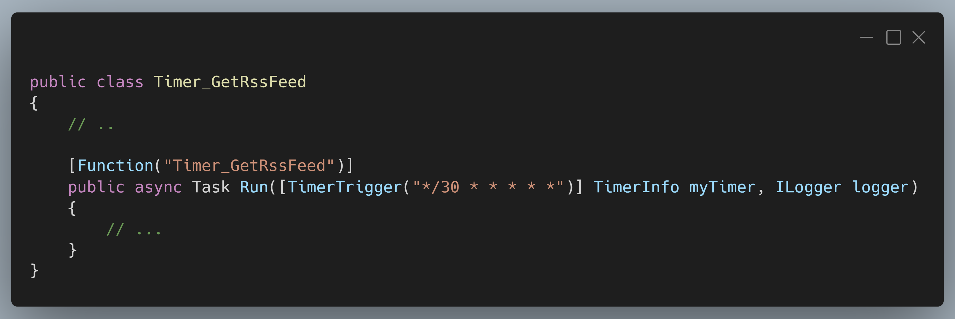
Azure Functions
Notes:
QueueTrigger
HttpTrigger
Maybe discuss service bus topics too?
SCREENSHOT: https://carbon.now.sh/?bg=rgba%28171%2C+184%2C+195%2C+1%29&t=vscode&wt=boxy&l=text%2Fx-csharp&width=680&ds=true&dsyoff=20px&dsblur=68px&wc=true&wa=true&pv=11px&ph=10px&ln=false&fl=1&fm=Hack&fs=14px&lh=133%25&si=false&es=4x&wm=false&code=public%2520class%2520Timer_GetRssFeed%250A%257B%250A%2509%252F%252F%2520..%250A%2520%2520%250A%2520%2520%2520%2520%255BFunction%28%2522Timer_GetRssFeed%2522%29%255D%250A%2520%2520%2520%2520public%2520async%2520Task%2520Run%28%255BTimerTrigger%28%2522*%252F30%2520*%2520*%2520*%2520*%2520*%2522%29%255D%2520TimerInfo%2520myTimer%252C%2520ILogger%2520logger%29%250A%2520%2520%2520%2520%257B%250A%2520%2520%2520%2520%2520%2520%2520%2520%252F%252F%2520...%250A%2520%2520%2520%2520%257D%250A%257D

Slide 38
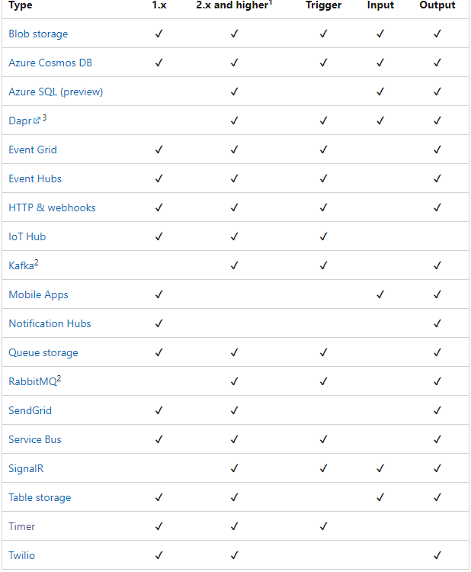
Notes:
Triggers – input and output bindings

Slide 39
Demo
Azure Functions

Slide 40
Azure Functions
Pros
Precise scheduling and timing!
Tons of trigger options
CLOUD SCALE
Tasks are independently resilient
Cons
Azure requirement

Slide 41
Conclusions
Notes:
Important to abstract out background tasks from your UI or front facing work

Slide 42
😭 Thanks, goodbye!
Kevin Griffin
consultwithgriff.com
twitter.com/@1kevgriff
bbiz.io/@1kevgriff

